Slide 1
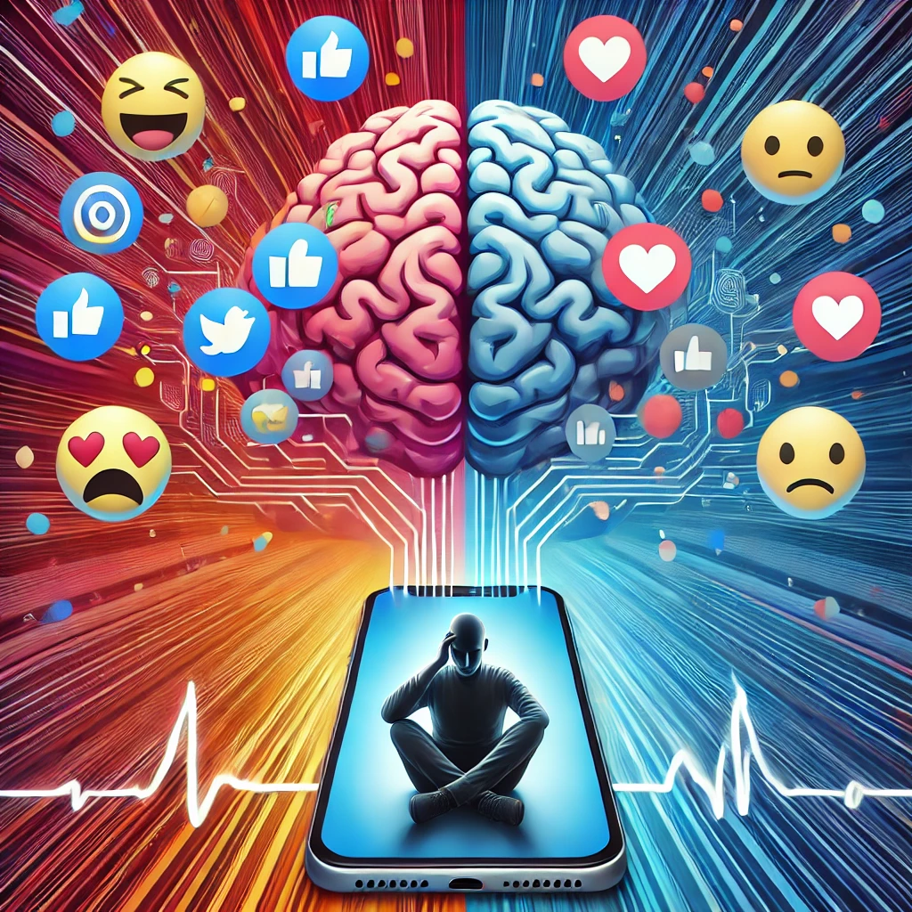
Mind Over Media:
The Social Media Mental Health Saga
An Analysis By:
Alex Dunn
Kene Ezeagba
Kathryn Kavanagh
Jerome Stepp
Randon White

Slide 2
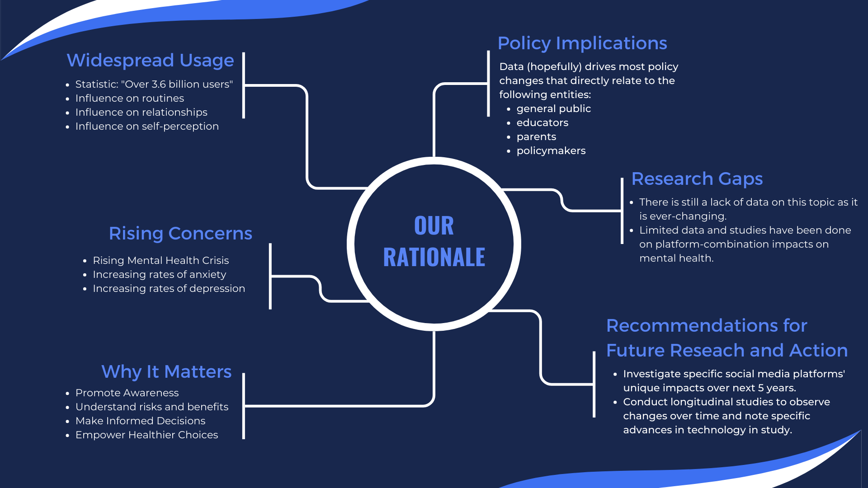

Slide 3







Platform-Specific Insights: Social Media and Mental Health
How Do They All Stack Up?
By: Kathryn Kavanagh

Slide 4
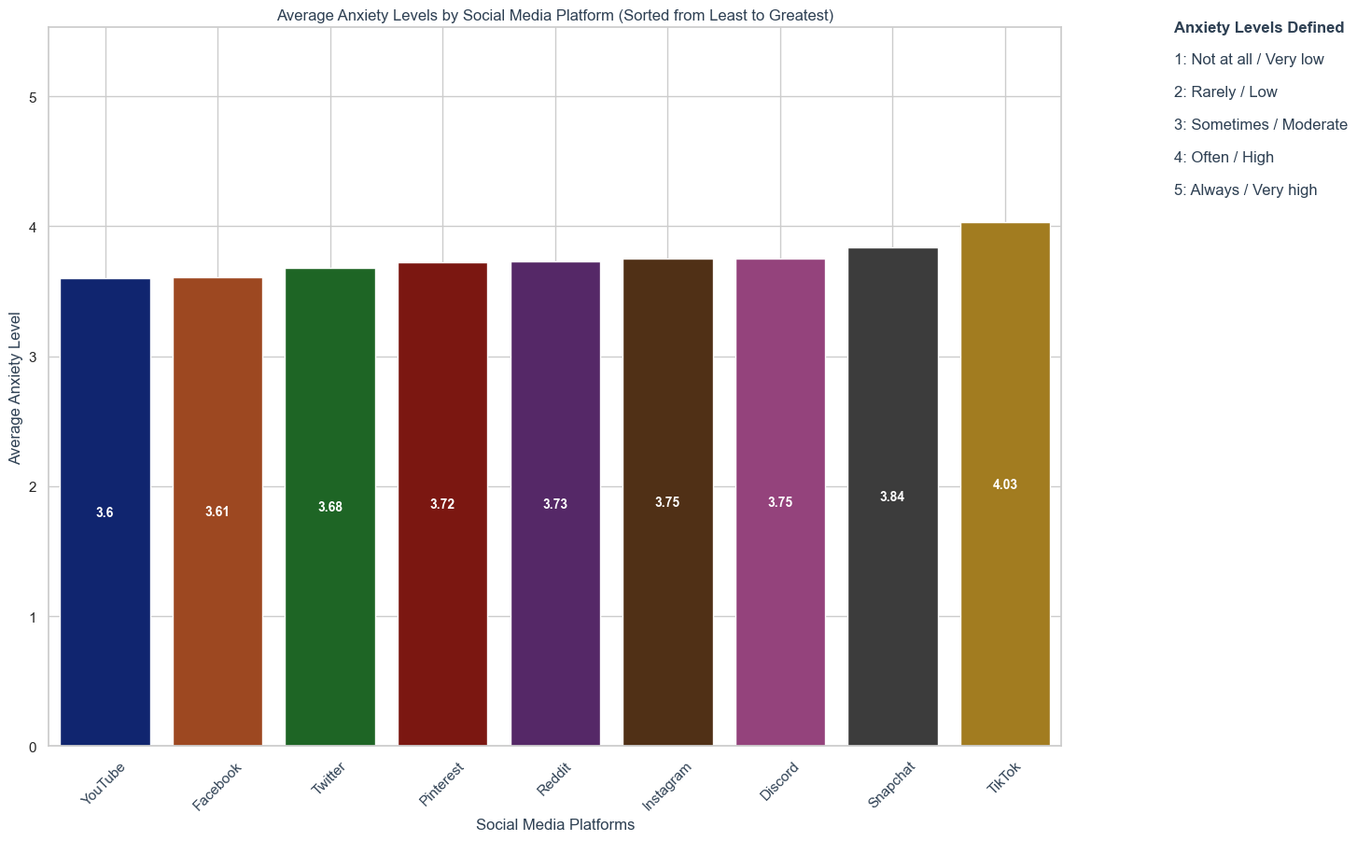
Average Anxiety Levels by Social Media Platform
By: Kathryn Kavanagh

Slide 5
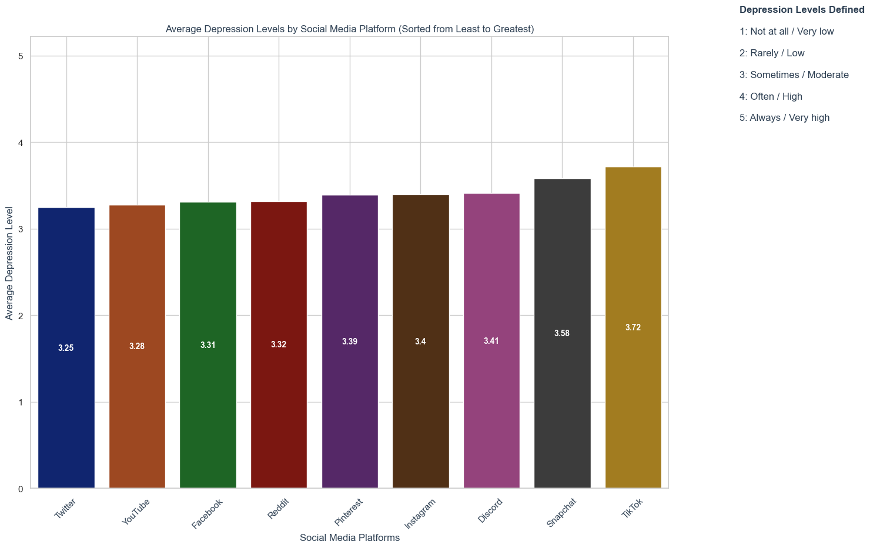
Average Depression Levels by Social Media Platform
By: Kathryn Kavanagh

Slide 6
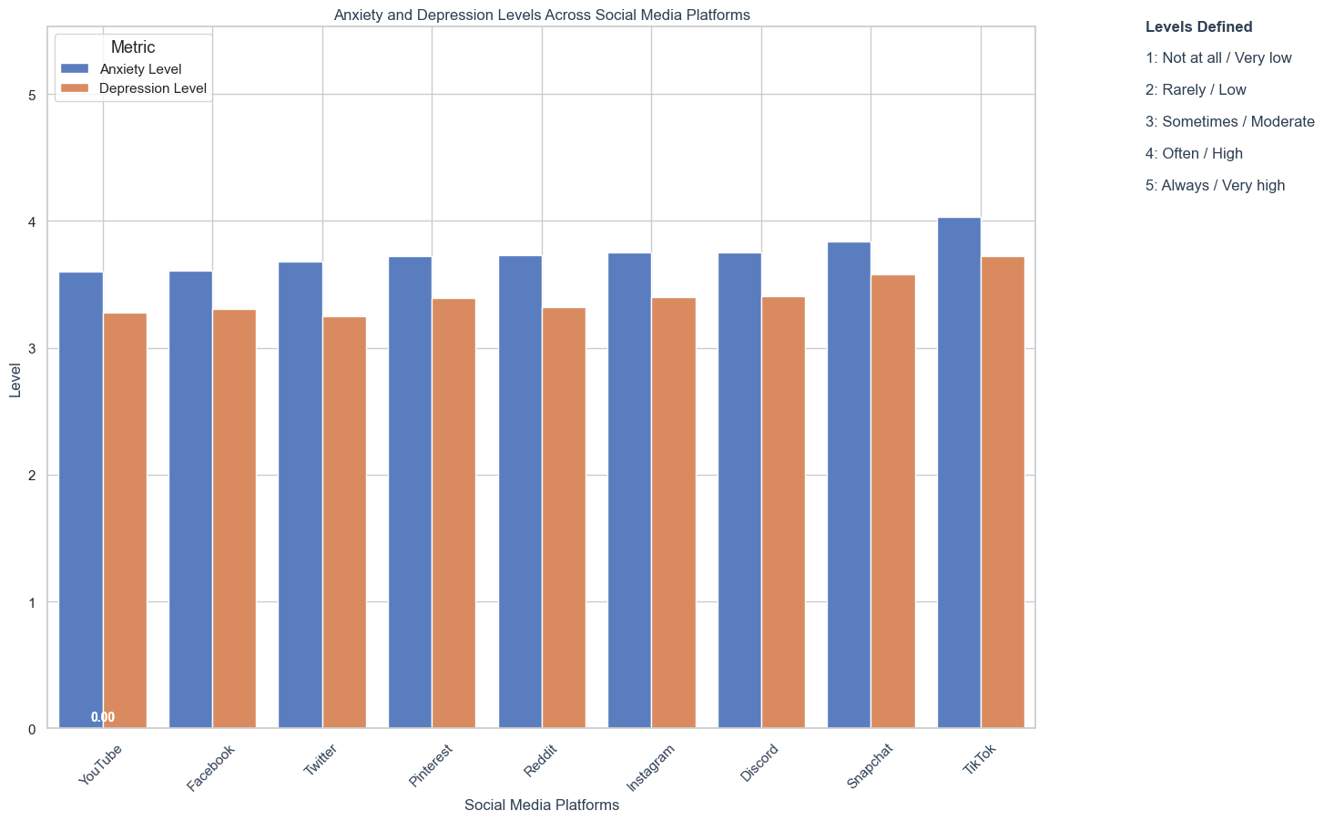
Social Media Combined Anxiety and Depression
Analysis:
- Across all social media platforms, users consistently report higher levels of anxiety compared to depression.
- There is a trend across all social media platforms where higher anxiety levels are associated with higher rates of reported depression.
- While some social media platforms show higher levels of anxiety and depression than others, the overall trend indicates that increased anxiety is generally accompanied by increased depression rates across all platforms.
By: Kathryn Kavanagh

Slide 7
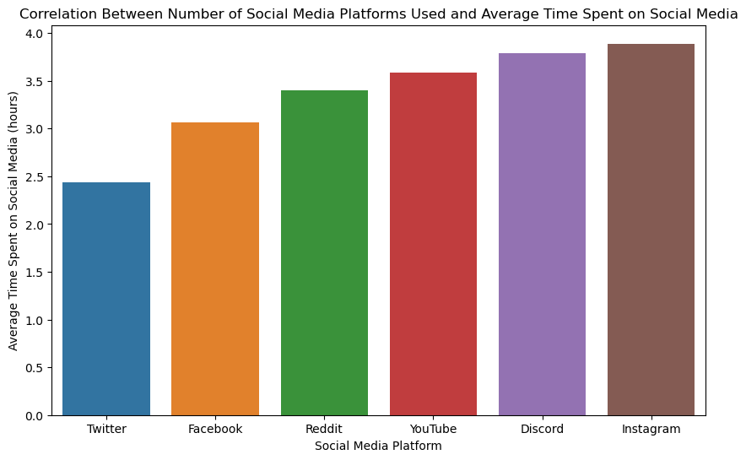
Social Platforms and Average Time on Social Media Statistics
Discussion:
This insight highlights the interconnected nature of social media consumption, where increased platform variety corresponds to greater total engagement time, potentially due to the unique content and interactions each platform offers.

Slide 8
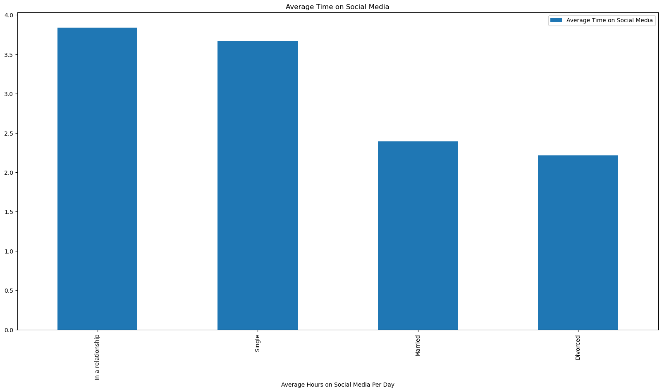
Average time on Social Media by relationship status

Slide 9
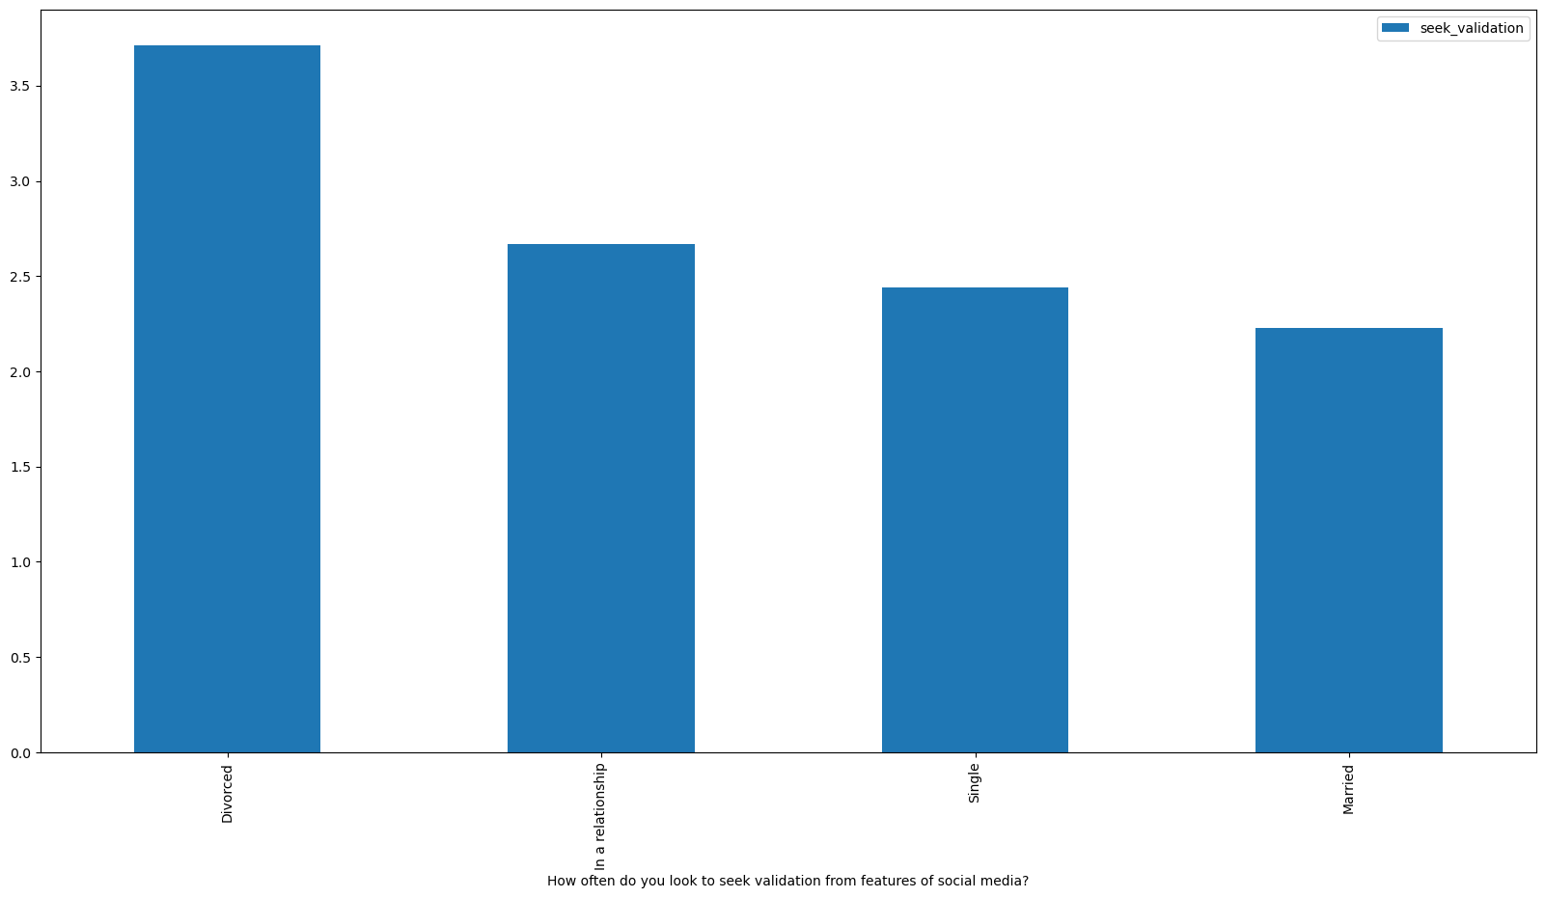
Seeking validation through Social Media by relationship status

Slide 10
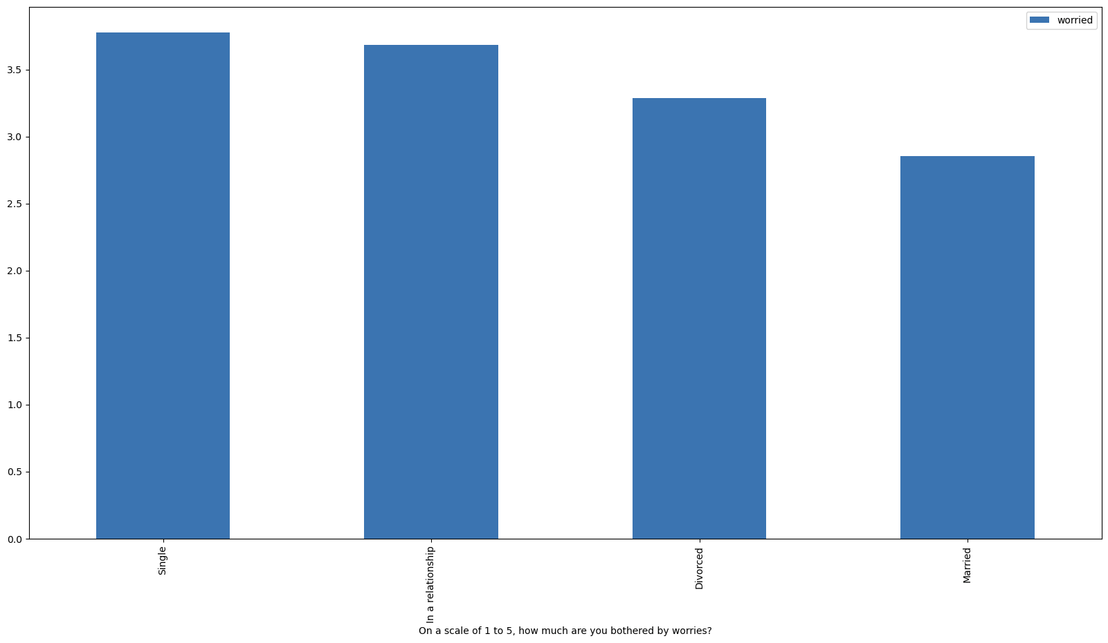
How bothered by worries people are by relationship status

